Slide 1
World Happiness Report 2024 Analysis
Dashboard Project – Intro to Business Analytics & Big data
B.Bhargavi | Z23765251
K.Sai Charan | Z23811639
M.Pavani | Z23807763

Slide 2
Introduction
Project Aim This Power BI project analyzes global happiness by identifying key drivers like GDP, life expectancy, and social support. It highlights regional variations to support policy decisions and global well-being strategies.
📊 Dataset: World Happiness Report 2024
Source: Kaggle – WHR 2024
Key Measures: Ladder Score, GDP per capita, Social Support, Healthy Life Expectancy, Freedom, Generosity, Corruption, Dystopia + Residual

Slide 3
Methodology
🛠️ Tool Utilized: Power BI
Power BI was selected for its robust data modeling, dynamic dashboarding, and interactive visualization features. Its user-friendly interface allows for effective exploration and storytelling with data.
Advanced Capabilities: DAX functions, calculated fields, and relationship modeling enabled in-depth happiness score analysis.
Interactive Features: Slicers, tooltips, and dynamic visuals allowed users to filter and explore data by region, factor, and country.
Visual Customization: A wide range of charts (maps, bars, lines, donuts) was used with consistent color schemes for clarity and engagement.

Slide 4
Visualization Creation Process
✅ Data was cleaned and transformed in Power Query for accuracy and consistency
📊 Multiple chart types were used:
Bar, Pie, Line, Map, and Donut Charts
🧩 Slicers and Tooltips enabled dynamic filtering and enhanced interactivity
🎨 Standardized color schemes and clear labels improved visual clarity
📈 Dashboards were designed for easy comparison and actionable insight extraction

Slide 5
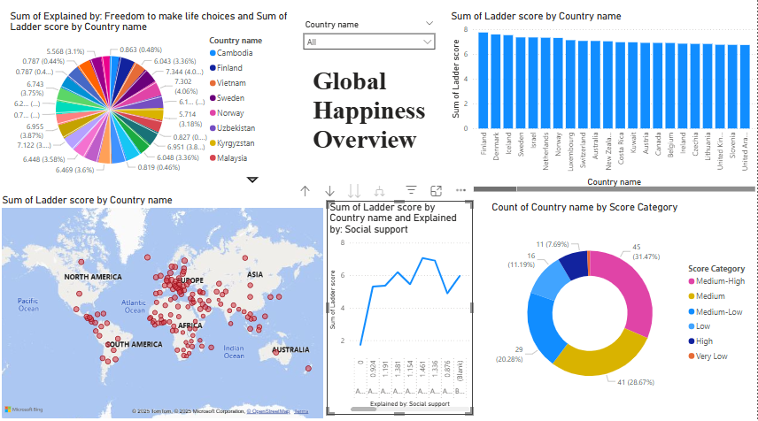
Dashboard-1
Positive Insight
🌍 High happiness levels are seen in Europe, the Americas, and "Other" regions, while Asia and Africa show moderate but rising well-being.
Negative insight
🌏 Oceania, Africa, and the Middle East report lower Ladder Scores, driven by weaker social support and freedom indicators.

Slide 6
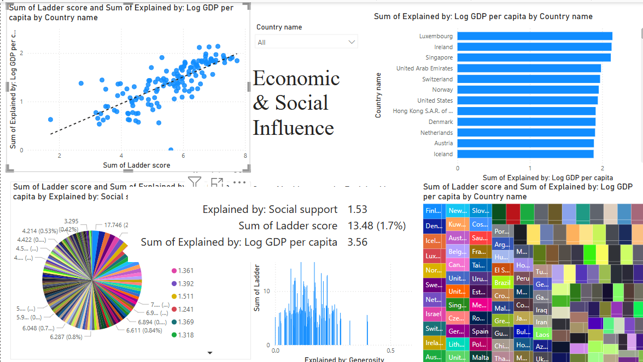
Dashboard-2
Positive Insight
💰 Strong Economic & Social Factors GDP, social support, and healthy life expectancy drive happiness—especially in North America & Oceania.
Negative Insight
🌍 Regional Disparities Africa & the Middle East report low social support, affecting overall happiness levels.

Slide 7
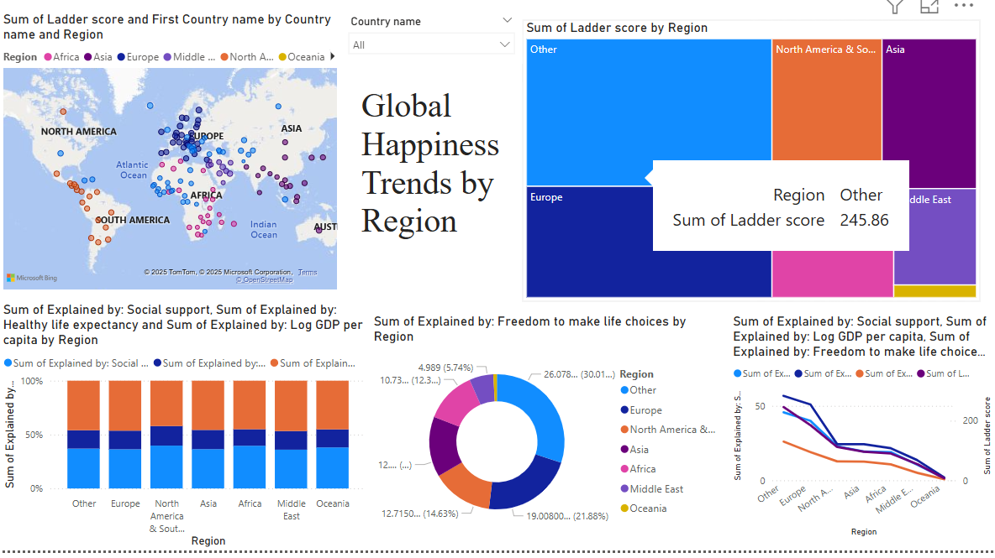
Dashboard-3
Positive Insight
🏆 High Scores & Key Drivers Europe, North America, and "Other" regions lead in happiness, driven by strong social support, life expectancy, and freedom of choice.
Negative Insight
📉 Lower Regional Well-being Oceania, Africa, and the Middle East report lower ladder scores, with weaker contributions from critical factors like social support and freedom.

Slide 8
Conclusion
Power BI analysis revealed clear differences in well-being across regions.
Key happiness drivers: Social support, Healthy life expectancy, GDP, and Freedom of choice.
Developed regions show high, stable scores, while Oceania, Africa, and the Middle East lag behind.
Dashboards enabled clear, evidence-based insights into global happiness trends.
Findings emphasize the importance of targeted social investments and policies.
This project highlights the power of data visualization in shaping impactful decisions.

Slide 9


